Slide 1
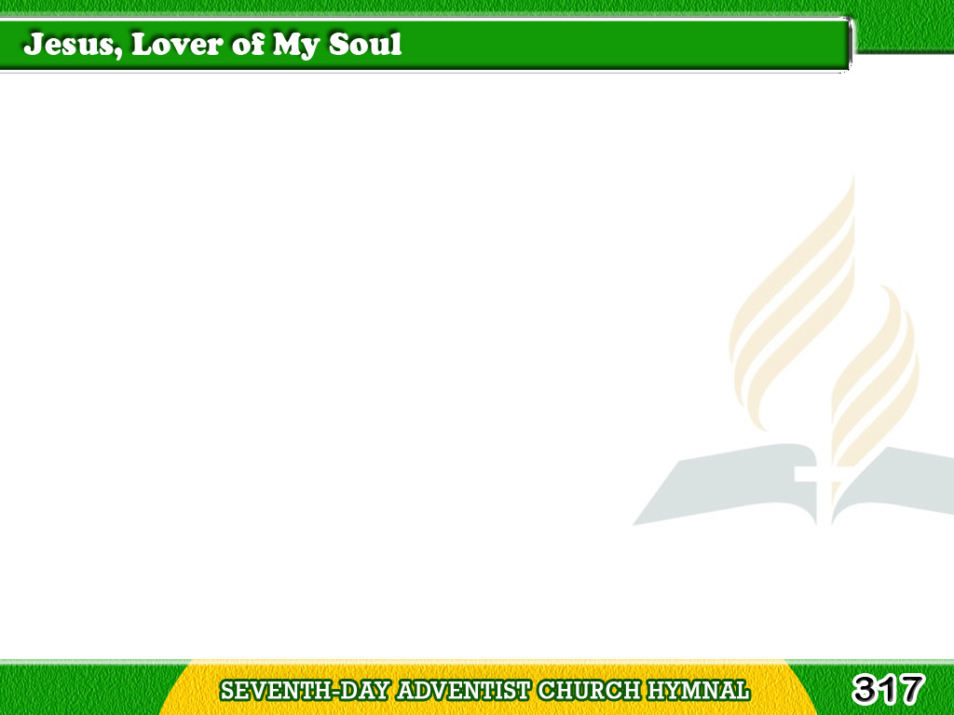
1/4
Jesus, lover of my soul,
Let me to Thy bosom fly,
While the billows near me roll,
While the tempest still is high;
Tagalog
Version

Slide 2
1/4
Hide me, O my Savior, hide!
Till the storm of life is past;
Safe into the haven guide,
O receive my soul at last!
Tagalog
Version

Slide 3
2/4
Other refuge have I none,
Hangs my helpless soul on Thee;
Leave, O leave me not alone!
Still support and comfort me;
Tagalog
Version

Slide 4
2/4
All my trust on Thee is stayed,
All my help from Thee I bring;
Cover my defenseless head
With the shadow of Thy wing.
Tagalog
Version

Slide 5
3/4
Thou, O Christ, art all I want,
More than all in Thee I find;
Raise the fallen, cheer the faint,
Heal the sick, and lead the blind.
Tagalog
Version

Slide 6
3/4
Just and holy is Thy name,
I am all unrighteousness;
Vile and full of sin I am,
Thou art full of truth and grace.
Tagalog
Version

Slide 7
4/4
Plenteous grace
with Thee is found
Grace to pardon all my sin;
Let the healing streams abound,
Make and keep me pure within;
Tagalog
Version

Slide 8
4/4
Thou of life the Fountain art,
Freely let me take of Thee;
Spring Thou up within my heart,
Rise to all eternity.
Tagalog
Version

